Slide 1
本征图像论文汇报（四）
汇报人：方阳

Slide 2
Content
1. Intrinsic Decomposition of Image Sequences from Local Temporal Variations（ICCV2015）

Slide 3
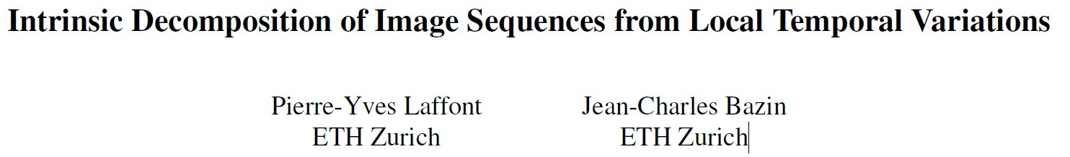

Slide 4
Contributions
derive a local energy that relates reflectance values within each neighborhood by analyzing the local color variations observed over time. This term is locally adaptive as it enforces smooth shading only on the relevant pixels, and automatically detects regions with sudden shading changes due to shadows or normal/depth discontinuities.
reliable pairwise constraints on the reflectance of distant pixels that are oriented consistently and have similar shading over time(without prior knowledge of the lighting or geometry).

Slide 5


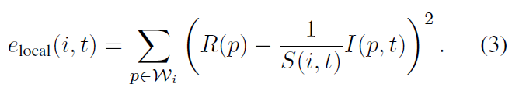
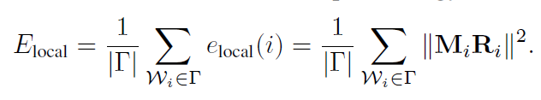



Local constraints from temporal color variations

Slide 6


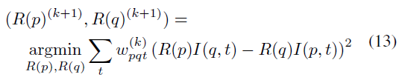

Pairwise constraints from shading consistency

Slide 7
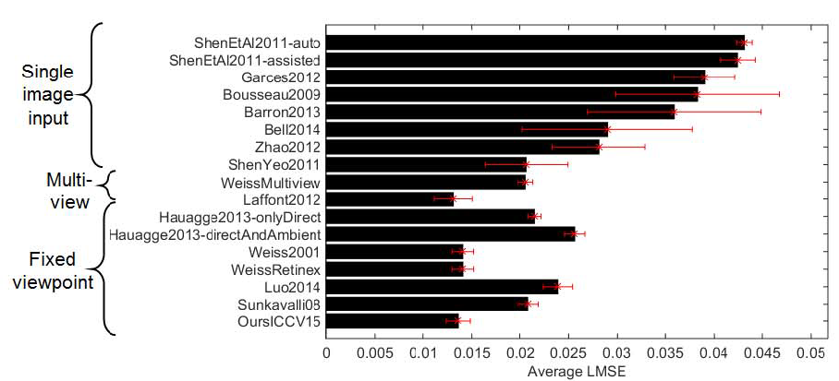
Experiments——synthetic St. Basil dataset

Slide 8
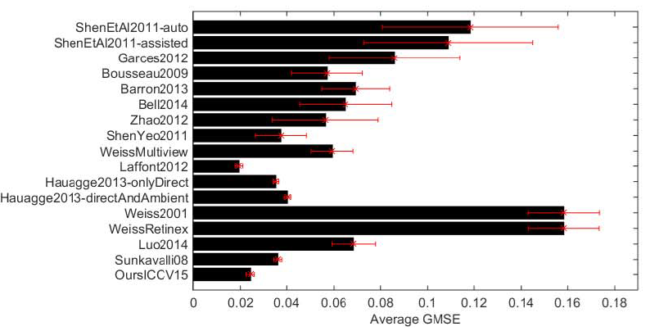
Experiments——synthetic St. Basil dataset

Slide 9
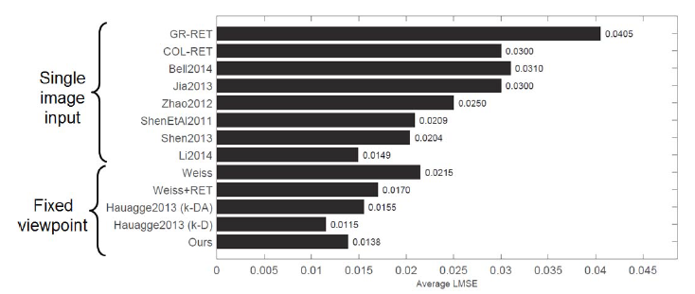
Experiments——MIT dataset

